Slide 1
Colorectal Cancer and the Microbiota Meta-analysis
Marc Sze
September 14th, 2017

Slide 2
Previous Studies that use existing data
9 data sets (total n = 495)
Qiime-CR
SS-UP
Main focus of paper was on biomarkers
Alpha metrics
Beta metrics
Relative Abundance (DeSeq2)
Select OTU analysis (Fold Change)
RF Prediction
Notes:
Qiime-CR = Qiime closed reference
SS-UP = Strain Select UPARSE –Second Genome Proprietary software based on de novo clustering – gets down to strain classification
RF = Random Forest

Slide 3
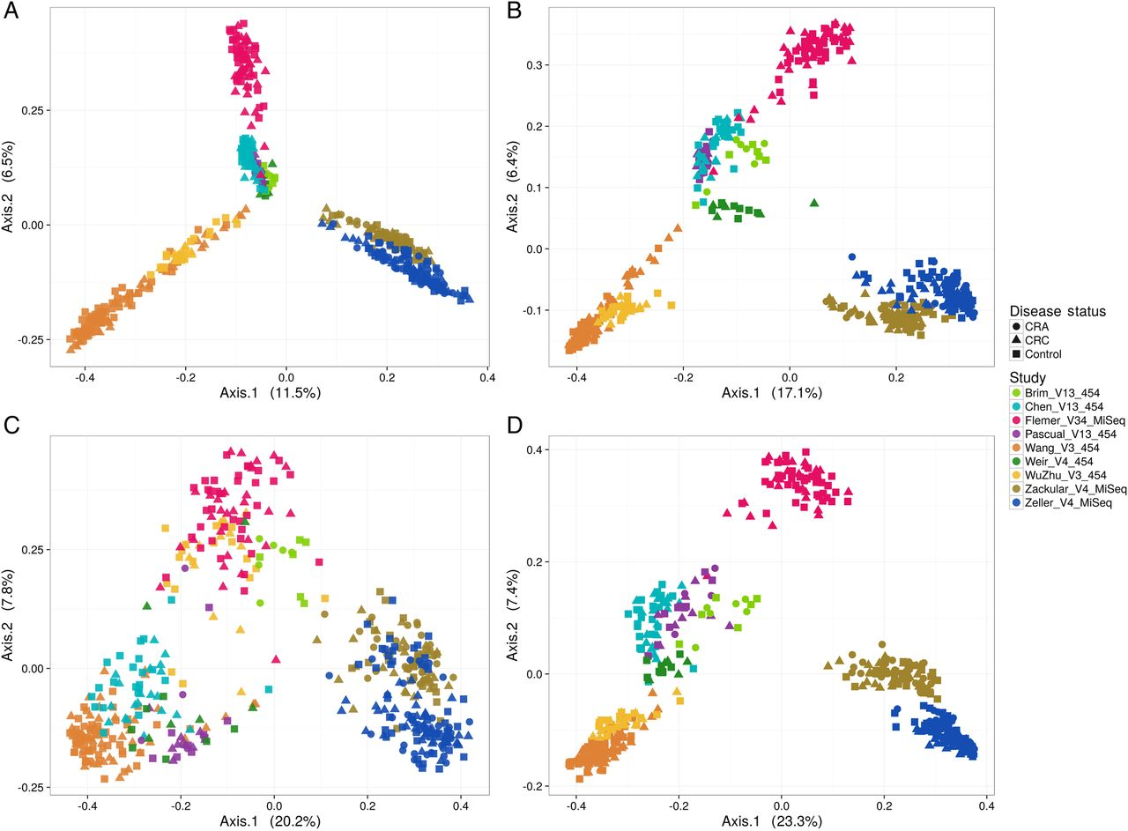
Strong study effect regardless of clustering method
Notes:
Principal coordinates analysis depicting the relationship between microbial composition from different study cohorts and their phenotypes. Plot points indicate individual samples, shapes indicate disease status (colorectal adenoma (CRA), colorectal cancer (CRC)) and colours indicate various studies included in the meta-analysis (target gene and sequencing platform are also incorporated in the study acronym). Communities are compared using Bray-Curtis (A and C) dissimilarity and the Jaccard index (B and D). (A) and (B) The ordination on QIIME closed reference operational taxonomic unit abundance tables. Cohorts cluster tightly illustrating a strong study effect followed by the gene target region sequenced. (C), (D) Show the ordination on Strain Select, UPARSE bioinformatics pipeline (SS-UP) abundance tables. Although the study effect is strong, there is more discrimination in cases and controls (% variation explained) by the ordinations on SS-UP abundances for both the Bray-Curtis dissimilarity and Jaccard index.

Slide 4
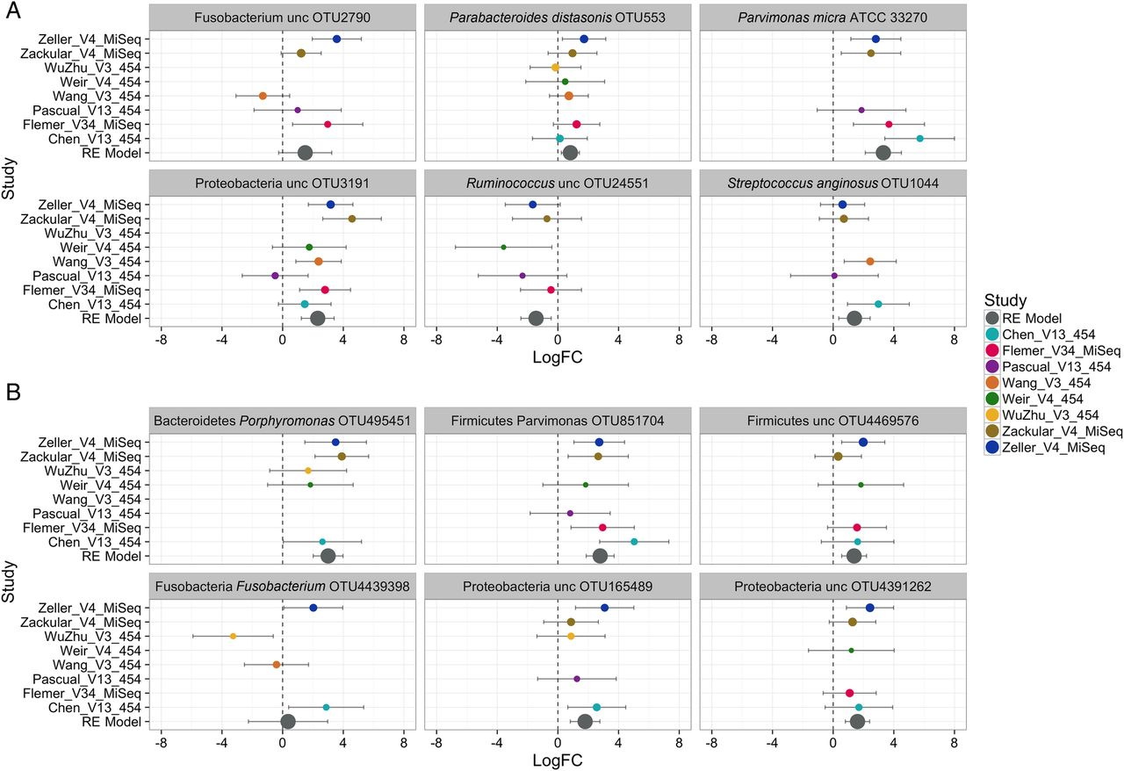
Some OTUs show a consistent signal across study
Notes:
Forest plot of selected Strain Select, UPARSE bioinformatics pipeline (SS-UP) (A) and QIIME-CR operational taxonomic units (OTUs) (B). The plots depict per-study and adjusted random effects model (REM) log₂fold change across all studies for OTUs that were detected in ≥5 studies. All OTUs depicted here had an REM FDR<0.1 and the commonly reported Fusobacterium included as well. The length of the error bar depicts the 95% CIs, and the size of point indicates the precision of the point estimate for individual studies (1/(95% CI upper bound – 95% CI lower bound). The RE model point size is fixed. Blank values indicate that sequences for that specific OTU were not detected in that particular study. Taxonomic identities presented in (A) are genus, species, strain (or OTU ID if strain is unclassified) for SS-UP and phylum, genus, species (or OTU ID if species in unclassified) sequence for QIIME-CR in (B). LogFC, log₂fold change.

Slide 5
Background on our study using previous data
14 data sets (total n = 2109)
Main focus is not on identifying biomarkers
Stool
Tissue
mothur – opticlust denovo
Adenoma versus CRC
Stool versus tissue differences
Alpha metrics
Beta metrics
Select OTU analysis
RF Prediction

Slide 6
What is the main goal?
Notes:
What larger picture would this meta analysis be a part of?

Slide 7




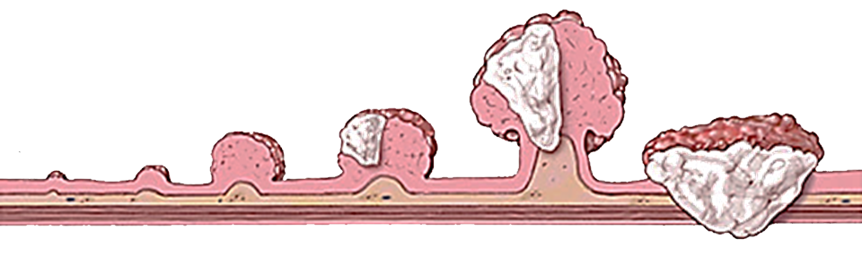












The popular current disease model
Adenocarcinoma
Fusobacterium nucleatum
Porphyromonas asaccharolytica
Parvimonas micra
Peptostreptococcus spp
Severe Dysplasia
(Precancerous
Polyp)
Large
Polyp
Cancer
Hyper-
proliferation
Small
Polyp
NF-kB
MAMP
Macrophage
TLR
Adapted from John Hopkins Colon Cancer Center
Adapted from Keku TO, et al. Am J Physiol Gastrointest. 2015
Adapted from Flynn KJ, et al. mSphere. 2016

Slide 8
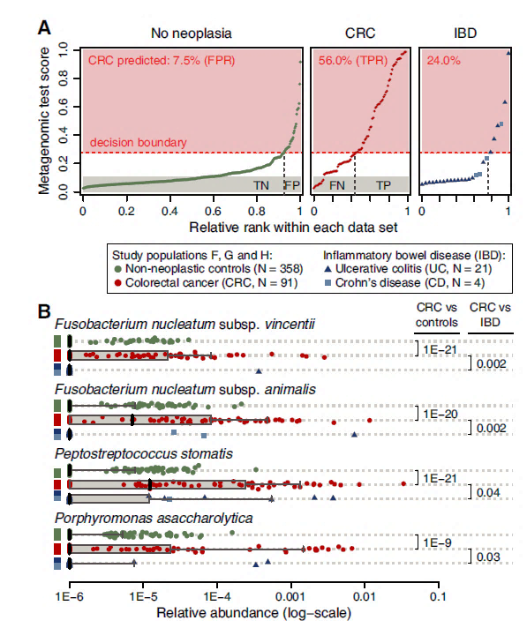
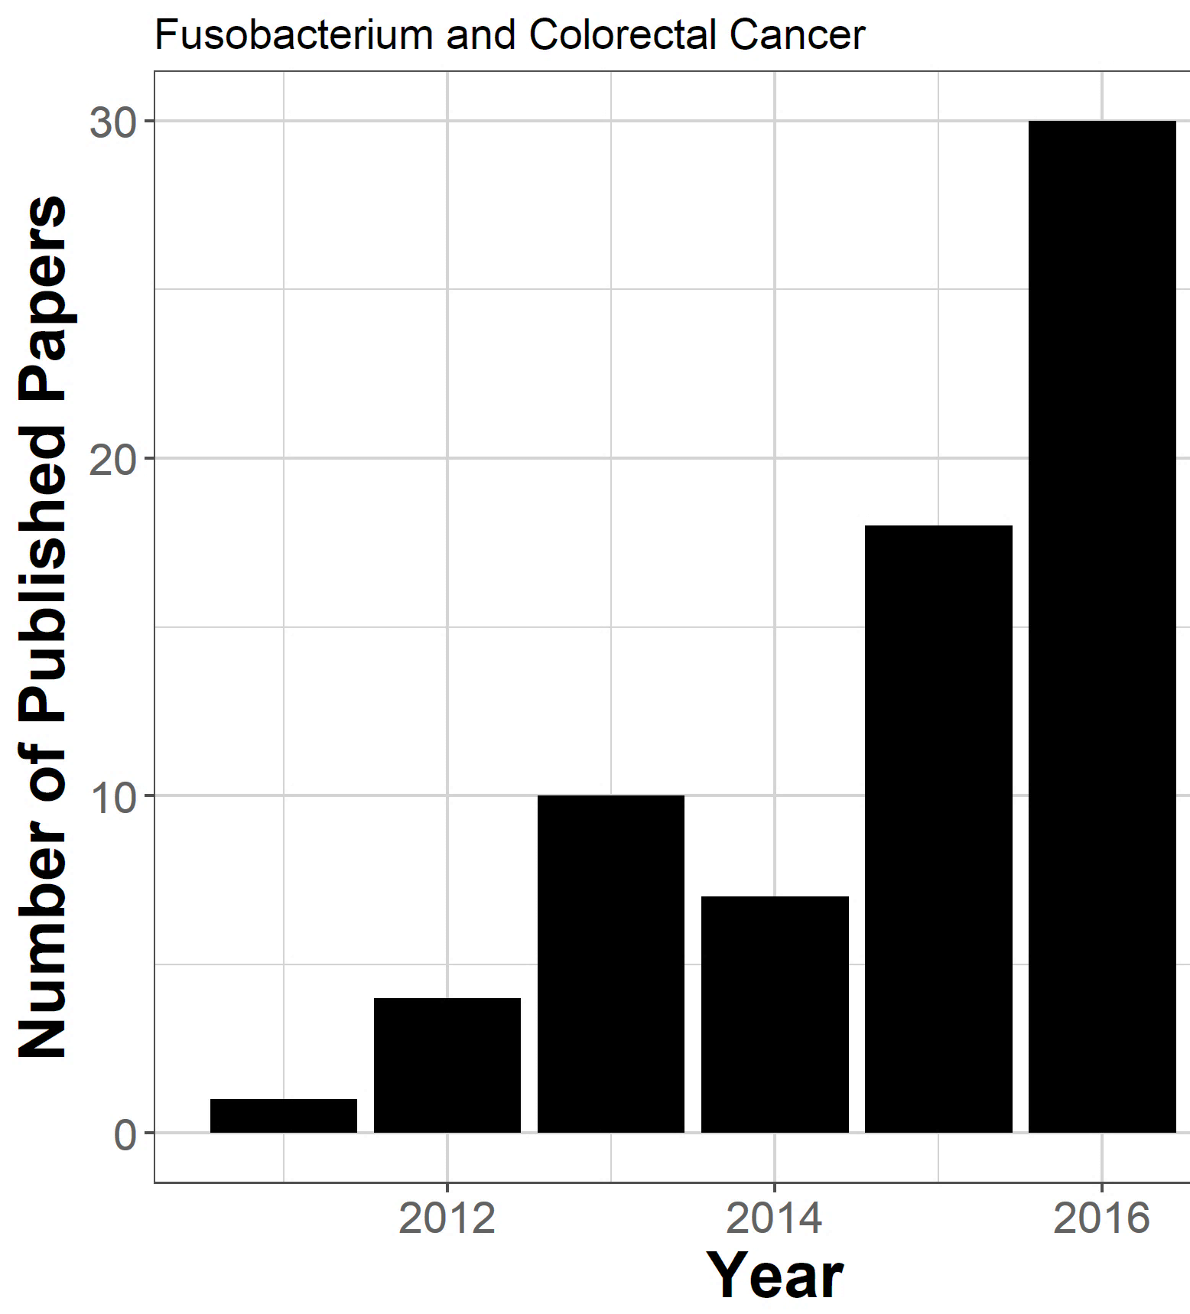
Narrowing in on a small set of bacteria
Zeller, et al. Mol Syst Biol. 2014

Slide 9
A rift on the current disease model
?
?
Adenocarcinoma
Severe Dysplasia
(Precancerous
Polyp)
Large
Polyp
Cancer
Hyper-
proliferation
Small
Polyp
John Hopkins Colon Cancer Center
Adapted from Flynn KJ, et al. mSphere. 2016

Slide 10
Support for rift: adenoma and advanced adenoma

Slide 11
Support for rift: carcinoma

Slide 12
Use the meta-analysis to provide stronger support for either the popular current model or the rift model
Notes:
I apologize in advance for all the tables….I haven’t got to the graphing yet

Slide 13
Stool: Difference between CRC and non-CRC
P-value | BH | Measure
0.00604 | 0.00604 | sobs
0.00285 | 0.00285 | Shannon
0.001484 | 0.00285 | evenness
Notes:
Ttest - No correction for study effects but all data have been power transformed and z-score normalized

Slide 14
Stool: Difference between control, adenoma, and CRC
Adjusted P-value | Comparison | Measure
0.014961 | control – cancer | sobs
0.129084 | adenoma – cancer | sobs
0.788565 | adenoma – cancer | sobs
0.001811 | control – cancer | Shannon
0.176192 | adenoma – cancer | Shannon
0.261279 | adenoma – cancer | Shannon
0.000758 | control – cancer | Evenness
0.283942 | adenoma – cancer | Evenness
0.078435 | adenoma – cancer | Evenness
Notes:
ANOVA with Tukey post hoc - No correction for study effects but all data have been power transformed and z-score normalized

Slide 15
Stool: Difference between control, adenoma, and CRC
Measure | Chi_sqaure | P-value | BH
Shannon | 4.795049 | 0.028542 | 0.042812
Evenness | 6.974876 | 0.008266 | 0.024799
sobs | 1.604378 | 0.205284 | 0.205284
Notes:
Using a linear mixed-effect model looking at control, adenoma, crc while correcting for study effects (is their a sustained increase/decrease)

Slide 16
Tissue: Difference between CRC and non-CRC
P-value | BH | Measure | Matched Tissue
0.141365 | 0.141365 | sobs | Yes
0.112641 | 0.141365 | Shannon | Yes
0.110498 | 0.141365 | Evenness | Yes
0.07097 | 0.173024 | Sobs | No
0.115349 | 0.173024 | Shannon | No
0.2101 | 0.2101 | Evenness | No
Notes:
Need to explain matched and unmatched (what happens during the sequence processing)

Slide 17
Tissue: Difference between control, adenoma, and CRC
Adjusted P-value | Comparison | Measure | Matched
0.031068 | control – cancer | sobs | No
0.956805 | adenoma – cancer | sobs | No
0.090058 | adenoma – cancer | sobs | No
0.031251 | control – cancer | Shannon | No
0.577201 | adenoma – cancer | Shannon | No
0.013365 | adenoma – cancer | Shannon | No
0.068341 | control – cancer | Evenness | No
0.405577 | adenoma – cancer | Evenness | No
0.010942 | adenoma – cancer | Evenness | No
Notes:
ANOVA with Tukey post hoc - No correction for study effects but all data have been power transformed and z-score normalized

Slide 18
Tissue: Difference between control, adenoma, and CRC
Measure | Chi_sqaure | P-value | BH | Matched
Shannon | 0.153872 | 0.694863 | 0.742262 | Yes
Evenness | 0.123245 | 0.725541 | 0.742262 | Yes
sobs | 0.108149 | 0.742262 | 0.742262 | Yes
Shannon | 3.913167 | 0.047909 | 0.107051 | No
Evenness | 3.251292 | 0.071367 | 0.107051 | No
sobs | 2.448095 | 0.117668 | 0.117668 | No
Notes:
Using a linear mixed-effect model looking at control, adenoma, crc while correcting for study effects (is their a sustained increase/decrease)

Slide 19
Bray-Curtis differences across groups: crc vs non-crc
Study | P-value | Sample Type | Matched
wang | 1.00E-04 | Stool | No
weir | 0.3431 | Stool | No
ahn | 0.0033 | Stool | No
zeller | 6.00E-04 | Stool | No
baxter | 0.0013 | Stool | No
hale | 0.7321 | Stool | No
flemer | 0.046 | Stool | No
sana | 0.0069 | Tissue | No
burns | 0.0995 | Tissue | No
flemer | 1.00E-04 | Tissue | No
chen | 0.2691 | Tissue | No
dejea | 0.2515 | Tissue | Yes
geng | 0.9816 | Tissue | Yes
burns | 1 | Tissue | Yes

Slide 20
Stool: select genera and the relative risk of crc
RR | CI_LB | CI_UB | P-value | Genus
1.937164 | 1.467286 | 2.557515 | 3.09E-06 | Fusobacterium
2.638431 | 2.210845 | 3.148715 | 5.64E-27 | Peptostreptococcus
1.784123 | 1.509694 | 2.108438 | 1.09E-11 | Porphyromonas
2.022664 | 1.64642 | 2.484889 | 1.97E-11 | Parvimonas
Notes:
Need to mention that it is based off of the median (high/low)

Slide 21
Tissue: select genera and the relative risk of crc
RR | CI_LB | CI_UB | P-value | Genus | Matched
1.883721 | 0.940156 | 3.774271 | 0.074111 | Fusobacterium | Yes
1.248617 | 0.422571 | 3.689426 | 0.687926 | Peptostreptococcus | Yes
1.89913 | 1.136173 | 3.174423 | 0.014404 | Porphyromonas | Yes
1.088153 | 0.55392 | 2.137632 | 0.806281 | Parvimonas | Yes
1.290043 | 1.003618 | 1.658211 | 0.046795 | Fusobacterium | No
1.358897 | 1.050938 | 1.757099 | 0.019342 | Peptostreptococcus | No
1.137798 | 0.761185 | 1.700749 | 0.529056 | Porphyromonas | No
1.424372 | 1.078631 | 1.880935 | 0.012648 | Parvimonas | No

Slide 22
A rift on the current disease model
Adenocarcinoma
Severe Dysplasia
(Precancerous
Polyp)
Large
Polyp
Cancer
Hyper-
proliferation
Small
Polyp
John Hopkins Colon Cancer Center
Adapted from Flynn KJ, et al. mSphere. 2016

Slide 23
To do list
Finish Stool Random Forest testing (genus)
Finish Stool Random Forest testing (OTU)
Complete Tissue Random Forest testing (genus and OTU)
Repeat full work flow for adenoma only

